Slide 1
EmpowHer
EmpowHER: Empowering Girls for Corporate Excellence Python Installation Kit

Slide 2
Agenda
Install Python
Install Visual Studio Code
Configuring Python interpreter in VS Code

Slide 3
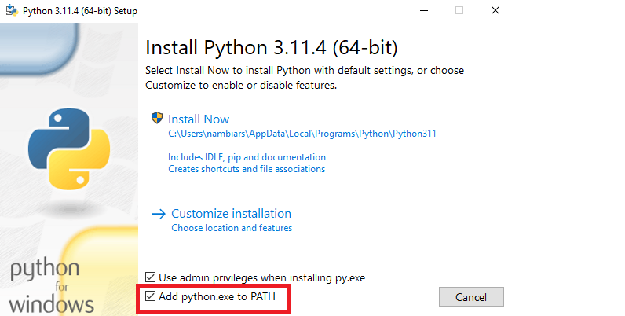
Install Python
Click the download link depending on your system (64bit , 32bit ) for the latest version of python
Open the python installer and select the “Add python.exe to PATH” checkbox and click Install now
Close once the installation is completed

Slide 4
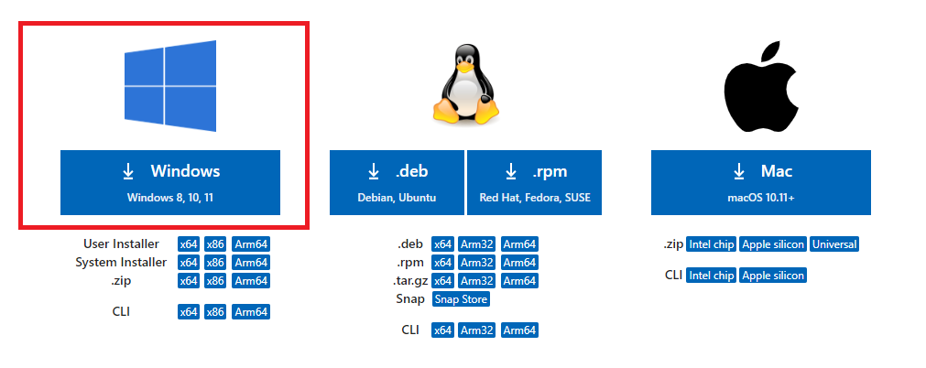
Install VS Code
Go to the download link and click the windows download icon
Open the VS Code installer and click “I accept the agreement” then Next checkbox and click Install now
Click Next until Install button appears then click install
Once installation is done close the installer and open the installed visual studio code app

Slide 5
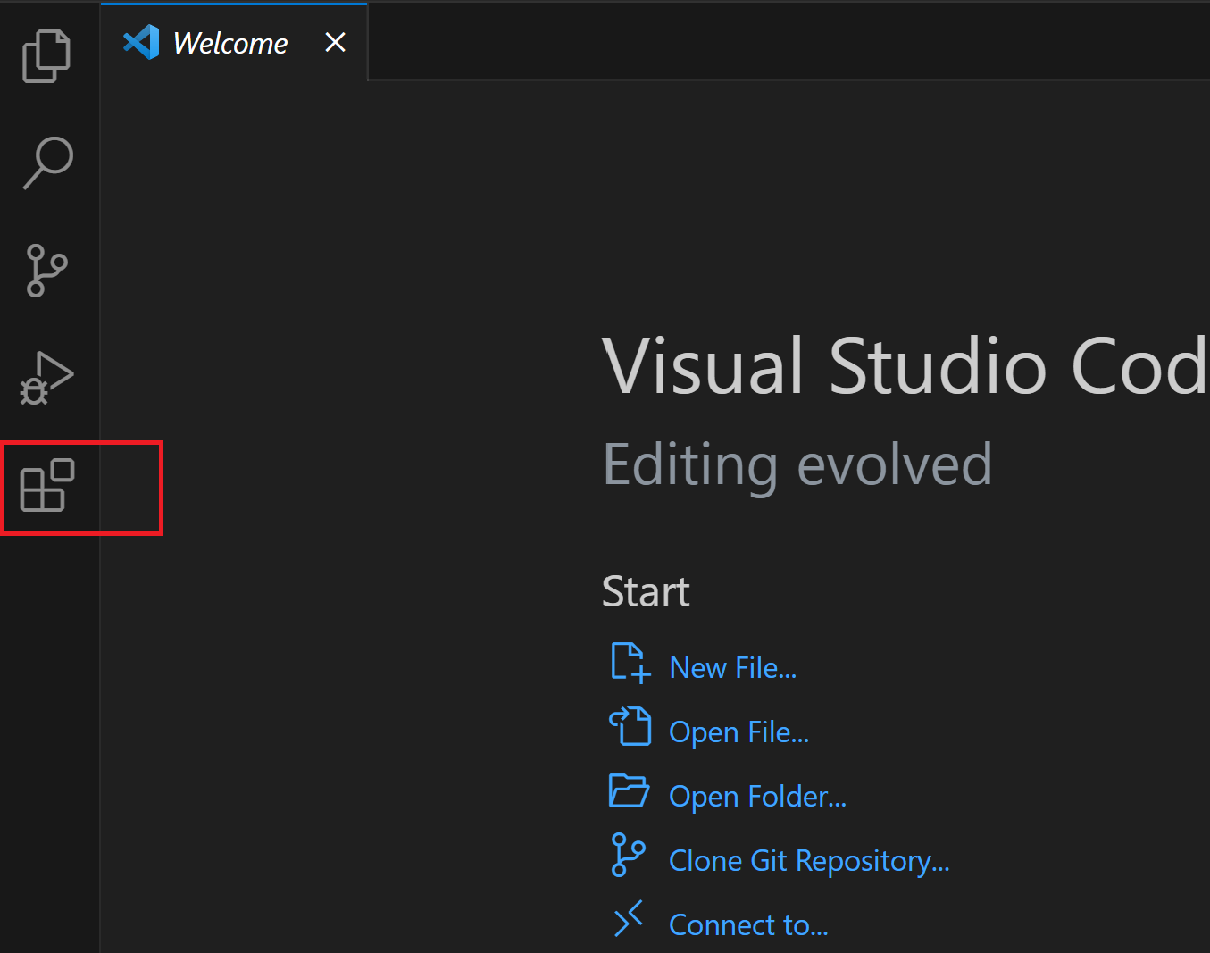
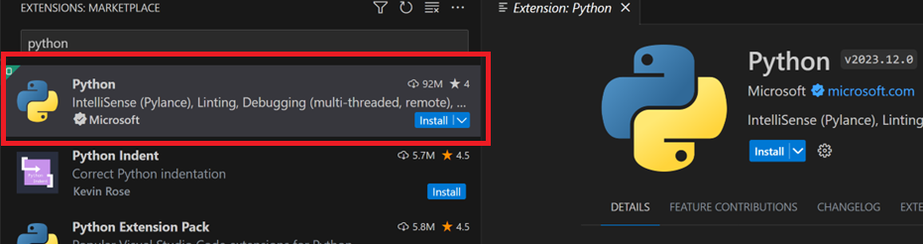
Install Python interpreter in VS Code
Open VS Code
Click on the “Extensions” Icon from the left side bar
Type “Python” in the search box and click the first search result
Click install

Slide 6
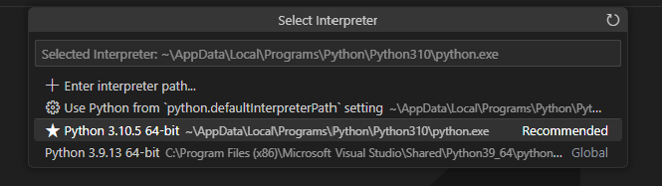
Install Python interpreter in VS Code
Press Shift+Ctrl+P simultaneously a window will pop up
Type “Python Interpreter” and click the first search result
Select the installed python interpreter path

